Slide 2
Recap of top Call reasons
Business Segment | Product Class (Size by Volume, Color by NPS %) | Recommendation Areas
1. Product Support |  | Computing Connectivity and Installation Hardware Software
 |  | Home Theater: Repair Appointment Scheduling Screens
2. Account Maintenance |  | Billing & Payments Black Tie Protection warranty Cancellations/renewals
 |  | Reward Zone Attaching points Missing Points Personal information updates
3. Post Purchase Support |  | Order Status & Cancellations Delivery confirmations ETA window Cancelling
 |  | Item Availability In Store Pickup
Computing
Home Theater
Appliance
Mobile
Entertainment
% of Call Center Volume
Privacy
MP3
Billing and Payments
Reward Zone
% of Call Center Volume
Receipts
Privacy
Home Theater
Computing
Mobile
Entertainment
Appliance
DI and Portable
Privacy
% of Call Center Volume
Gift Card
Notes:
Post Purchase support - TIMING

Slide 3

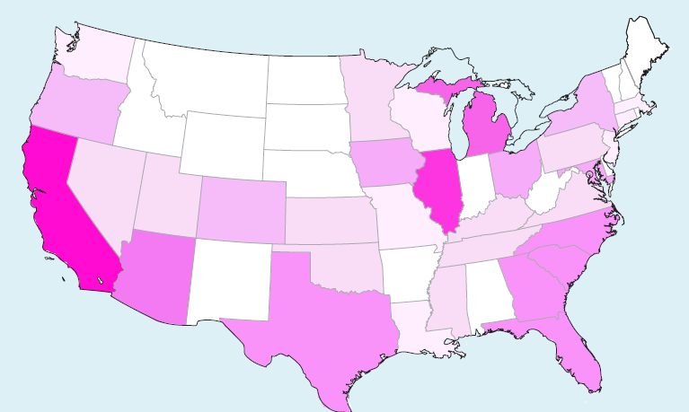
A Picture of the Garnier Hair Color Customer
In contrast to the L’Oreal Paris customers, Garnier Hair Color buyers are more concentrated in the southern region. They also have a stronger Mid-West and Western presence.
Garnier customers also identify primarily as Beauty Conscious but they have higher percentages of customers identifying as Minimalists and Product Junkies, as well.

Slide 4
Positive v. Negative Differentiators for Orbucks
Hotels
Great deals and great hotels available with Orbucks
Applying Orbucks
Disappointed at inability to use Orbucks on flights, deceit on inability to apply towards flight
Earning Orbucks
Confusion about how to apply Orbucks, multiple transactions required for hotel and air, limited time to use
1.
Highest praise area in positive reviews
Positives
533% fewer comments
+4.31 increase in sentiment
2.
Positives
550% fewer comments
+4.01 increase in sentiment
3.
Positives
350% fewer comments
+3.96 increase in sentiment
Lesser praise area in positive reviews
**Differentiators generated by evaluating deltas in positive and negative groups using Clarabridge’s Comparative Analysis tool

Slide 5
Mileage Plus Opinions Dislikes
GS level members are your most prized customers but they’re not always satisfied. By treating them with more priority during check-in, boarding and baggage processes, they will be more satisfied.
“With what I have seen of boarding recently, even if you are in first class, once general boarding has begun, you wait in a long line.”
Worse
Boarding Order/Priority
Boarding Upgrades
Check-in Priority
Carry-on Bags
Fit bag overhead
Free checked baggage
Boarding Accuracy
Boarding Pass Online
Gate Checked Baggage
Baggage Timeliness
“The agents should have VIP tags for gate checked luggage”
“As a global services member, I would like to be able to get upgraded earlier than at the gate”
“The inability to get a boarding pass online because of the stupidity of requiring that I request my ticket be re-issued when an upgrade was awarded.”
“Had to deboard with all carry-on luggage is a waste of time”
“The boarding process is not efficient due to the facts that the groups are so large”
“Often times there is no room for my overhead luggage because of all the other people boarding at the same time as me.”

Slide 6
High Income customers discuss Merchandise themes more negatively in 2013 than in 2012 especially around Quality and Finding Items
Neutral Sentiment
*Baseline sentiment based on average values for 2012
Notes:
Feb-April; year baseline

Slide 7
An increase in income parallels an increase in conversation around nearly all of Walmart’s operational touch-point areas
Increase in income parallels an increase in chatter around all areas except for price/value for which the opposite is true
Compared with 2012, HICs are speaking more about “Fast,” “Merchandise” and “Cleanliness”
**Bars may add up to more than 100% because any one sentence can be in more than one category resulting in higher than 100% sums when looking across all categories in the model
Notes:
Feb- apr; YOY

Slide 8
During the peak period of satisfaction instability, sentiment increases and becomes more stable as income decreases
Trend of sentiment of Operational Touch-Points and Marketing themes from Feb-March
Decreases in income change priorities of shoppers and their overall review:
More emphasis on Merchandise and Price/Value
Less variability in sentiment of review
Overall more positivity of experience in all touch-point areas

